Slide 1
Analysis of Survey Data

Slide 2
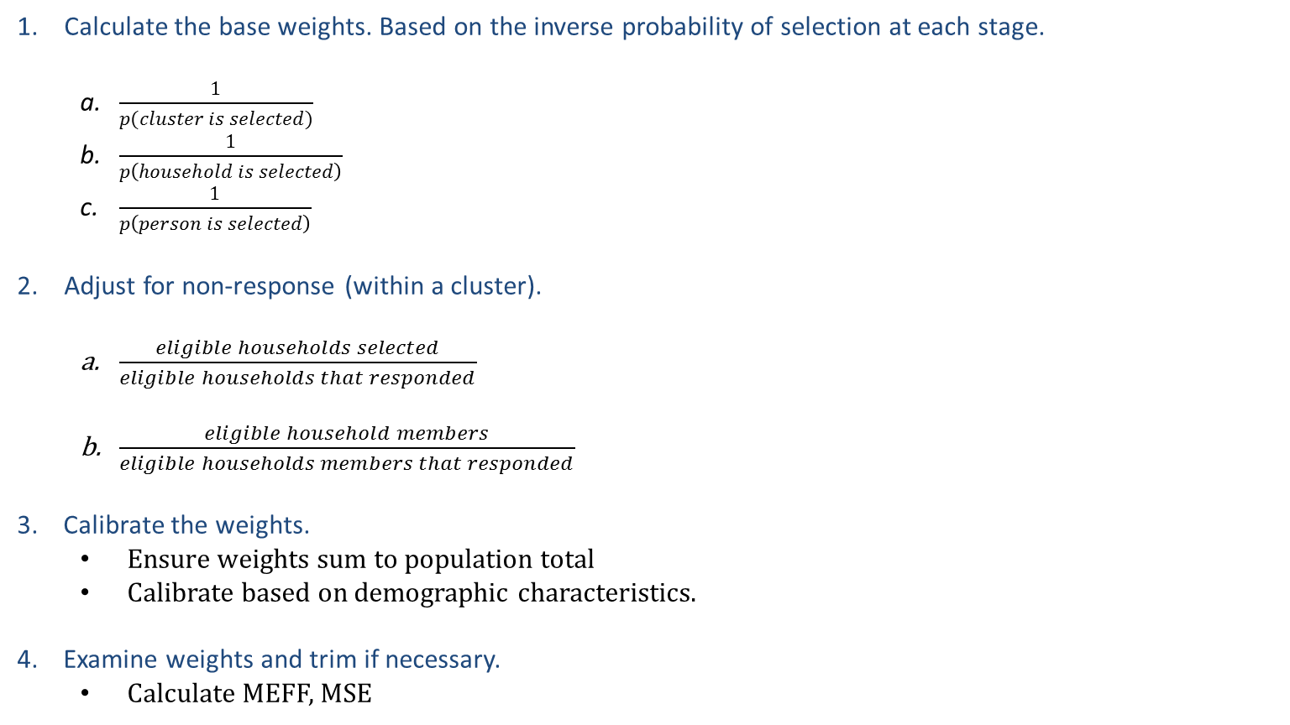
General weighting process
Calculate the base weights. Based on the inverse probability of selection at each stage.
$\frac{1}{p(cluster is selected)}$
$\frac{1}{p\left(household is selected\right)}$
$\frac{1}{p\left(person is selected\right)}$
Adjust for non-response (within a cluster).
$\frac{eligible households selected}{eligible households that responded}$
$\frac{eligible household members}{eligible households members that responded}$
3. Calibrate the weights.
Ensure weights sum to population total
Calibrate based on demographic characteristics.
4. Examine weights and trim if necessary.
Calculate MEFF, MSE
Notes:
Now I’m going to talk about the general process of weighting.
The first thing you need to do is calculate a base weight. What this will do is adjust for the difference in probability of selection. If someone was less likely to be selected for the survey, their weight should be larger. Because otherwise people less likely to be selected would be underrepresented. So you are accounting for probability of selection at each stage of selection. In this example, you are calculating a weight based on whether your cluster is chosen, whether you household is selected and then whether your person is selected.
The next thing to do is adjust for non-response. Here we are giving more weight to areas where the non-response rate was higher. If we did not adjust for non-response, then people who were less likely to respond would be underrepresented. Its important to note that there are 2 forms of non-response, household non-response and individual non-response. If you are selecting only 1 person per household, these are the same thing. But if you are selecting multiple people in a household, you will need 2 weights in this stage.
The 3rd step is to calibrate the weights. When we calibrate the weights what we are doing is ensuring that the weights sum of the population total. We can also make sure that the demographic characteristics in our sample and the same as the as in the population. When you do this, you ensure that you are accurately representing each group that you calibrate for.
The last step is to trim the weights, if it is necessary. And we will talk about that in a few slides.

Slide 3
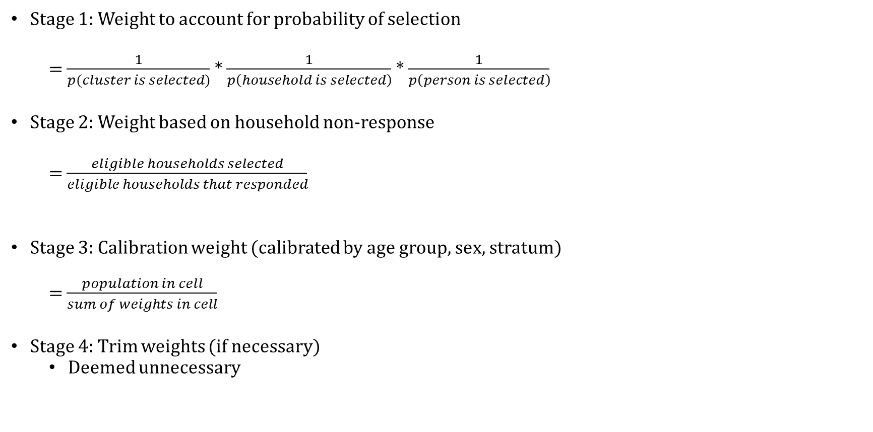
Weights for Georgian serosurvey
Stage 1: Weight to account for probability of selection
= $\frac{1}{p(cluster is selected)}$ * $\frac{1}{p\left(household is selected\right)}$ * $\frac{1}{p\left(person is selected\right)}$
Stage 2: Weight based on household non-response
= $\frac{eligible households selected}{eligible households that responded}$
Stage 3: Calibration weight (calibrated by age group, sex, stratum)
= $\frac{population in cell}{sum of weights in cell}$
Stage 4: Trim weights (if necessary)
Deemed unnecessary
Notes:
In the Georgia study, calculated the weights as follow. We account for the probability of all stage of selection.
Then we accounted for household non-response. There was no individual non-response because we were only interviewing one person per household.
Next we calculating calibration weights to make sure our weights summed correctly by age group, sex and stratum
And lastly we looked at trimming weights, which we ultimately deemed unnecessary.
$\frac{1}{p(cluster is selected)}$ * $\frac{1}{p\left(household is selected\right)}$ * $\frac{1}{p\left(person is selected\right)}$ = $\frac{\# of clusters}{\# of selected clusters}$ * $\frac{\# of households}{\# of selected household}$ * $\frac{\# of people in household}{1}$ (in our case)
Stage 1 : If we did not weight, the probability of selection would not the same for all participants
People from larger clusters would be less likely to be included in the sample
Stage 2: If we did not weight, the probability of selection would not the same for all participants
People from larger clusters would be less likely to be included in the sample
Stage 3: If we didn’t weight, the probability of selection would not be the same for all participants
If 5 eligible people are in a household, each person only has a 20% chance of being selected.
If 1 eligible person is in a household, that person has a 100% chance of being selected

Slide 4
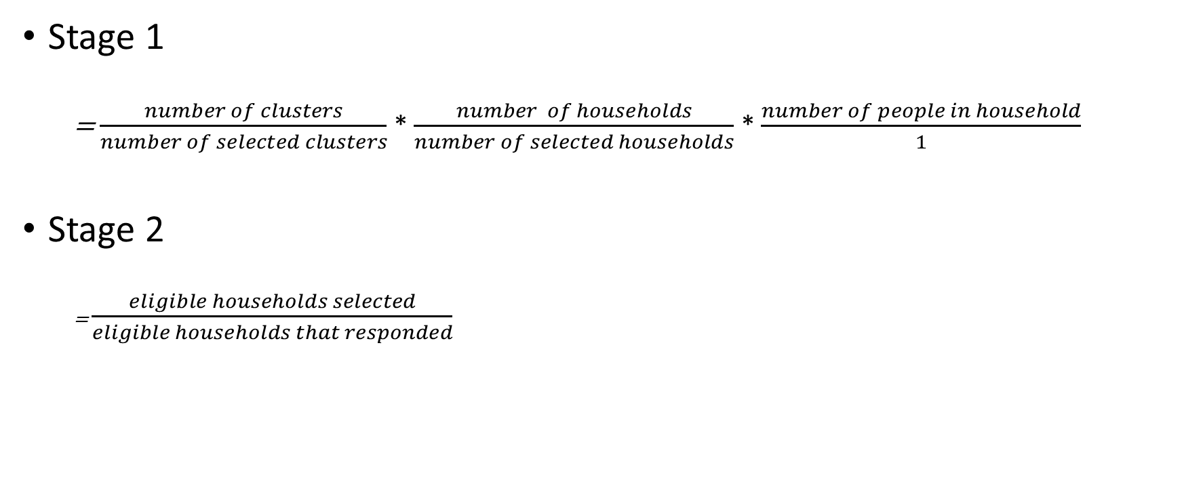
Stage 1 and stage 2 weights
Stage 1
= $\frac{number of clusters}{number of selected clusters}$ * $\frac{number of households}{number of selected households}$ * $\frac{number of people in household}{1}$
Stage 2
= $\frac{eligible households selected}{eligible households that responded}$
Notes:
Here again are the formulas for stage 1 and stage 2, I think they are pretty self explanatory. The formula for stage 1 is a little bit more explicit here.

Slide 5
Stage 3: Calibration weight
To calculate the calibration weights we:
Gathered population data by strata, sex and age group
Took the product of the base weights and non-response weight
Summed the product of the weights in each cell (each cell corresponds to a specific strata, sex, and age group)
Divided the population total (in each cell) by the sum of the weights (in each cell)
Notes:
The calibration stage is worth discussing a little bit more. Here are the steps for calculating the calibration weight.

Slide 6
Stage 3: Calibration weight
Calibrated by age, sex and stratum (ensured some of weights = population)
Population by Strata | Male |  |  | Female
 | <45 | 45-64 | > 65 | <45 | 45-64 | > 65
Tbilisi | 213,170 | 110,873 | 44,312 | 176,787 | 150,486 | 85,511
Adjara (except Batumi) | 37,686 | 21,018 | 8,986 | 35,424 | 22,606 | 12,947
Batumi | 31,358 | 16,286 | 5,315 | 25,381 | 20,051 | 8,851
Guria | 18,888 | 15,512 | 8,080 | 17,098 | 17,332 | 13,052
Imereti (except Kutaisi) | 64,977 | 54,527 | 29,558 | 58,361 | 57,549 | 45,000
Kutaisi | 26,938 | 17,034 | 6,734 | 21,680 | 20,053 | 12,274
Kakheti (except Telavi) | 44,077 | 34,021 | 18,323 | 40,282 | 37,078 | 27,606
Telavi | 3,504 | 2,151 | 936 | 2,985 | 2,798 | 1,796
Kvemo Kartli (except Rustavi) | 56,509 | 33,785 | 14,322 | 52,845 | 38,856 | 21,232
Rustavi | 25,982 | 13,651 | 3,994 | 19,467 | 16,737 | 6,983
Mtskheta-Mtianeti | 18,655 | 12,433 | 6,362 | 15,873 | 12,477 | 9,640
Racha-Lechkhumi, Kvemo Svaneti | 4,414 | 5,043 | 3,564 | 3,488 | 5,108 | 5,523
Samegrelo-Zemo Svaneti (except Zugdidi) | 39,002 | 30,955 | 14,695 | 35,435 | 34,648 | 24,648
Zugdidi | 7,227 | 5,178 | 2,306 | 6,018 | 6,690 | 4,308
Samtskhe-Javakheti | 29,006 | 19,756 | 8,885 | 28,463 | 22,226 | 13,466
Shida Kartli | 47,631 | 34,106 | 15,437 | 46,632 | 37,144 | 23,672
Notes:
So here is an example of the population cell counts so each of the groups that we are instead in calibrating on. So as an example maybe focus on that top left cell count which shows the population numbers for men under 45 in Tbilisi.

Slide 7
Stage 3: Calibration weight
Stratum | Sex | Age group | Sum of Weights | Population | Calibration weight
1 | M | <45 | 205504.21 | 213170 | 1.03730235
1 | M | 45-64 | 91320.67 | 110873 | 1.214106292
1 | M | > 65 | 38792.71 | 44312 | 1.142276474
1 | F | <45 | 291024.77 | 243810 | 0.837763741
1 | F | 45-64 | 191426.71 | 150486 | 0.78612854
1 | F | > 65 | 89337.02 | 85511 | 0.957173185
2 | M | <45 | 29658.63 | 31358 | 1.057297657
2 | M | 45-64 | 14895.71 | 16286 | 1.093334927
2 | M | > 65 | 2687.52 | 5315 | 1.977659701
2 | F | <45 | 47240.98 | 33407 | 0.707161452
2 | F | 45-64 | 22720.84 | 20051 | 0.882493781
2 | F | > 65 | 5209.58 | 8851 | 1.698985331
sum of weights * calibration weight = population
Notes:
You can see we have that same population number 213,170 in the top row here. We also have the sum of the weights
Sum of weights for all people in a given “group”

Slide 8
Calculating final weight
Take the product of the base weights, the non-response weight and the calibration weight to create a final weight
Final weight = base weight * non-response weight * calibration weight
Sum of weights should be equal to overall population
A weight is the number of people in the population a sampled person theoretically represents
Notes:
/*This is true in the aggregate and also for each subgroup you considered when calibrating. So the sum of all weights should equal the overall population and the sum of the weights within each subgroup should equal the population of that subgroup*/
And this makes sense if you think about theoretical idea behind a weight. A weight is the number of people in a population a sampled person represents. So you want your weights to sum to the population to ensure your whole population is properly represented.

Slide 9
Trimming Weights
The precision of a survey estimate depends on the sample design and the variation in sampling weights
MEFF – “multiplicative effect of weighting”
Trimming or truncating extreme weights can substantially reduce the overall variation in weights
Improves the precision of the estimates
Trimming of weights may introduce some degree of bias in an estimate
To justify trimming, gains in precision have to offset the increase in bias
MSE
Notes:
The next stage in the weighting process is to trim your weights.
So the first thing you want to do is measure the variability in your sampling weights, and to do that you can use a measure called MEFF, which stands for the multiple effect of weighting. The more variation you have in the weights the more variation you will have in your estimate. In an ideal world, you wouldn’t any variability in your weights, you would want all of your weights to be equal to 1, which would be the equivalent of sampling the entire population. In reality you will always have variability but you want to limit the amount of variability. If you have a high MEFF, say something above 2, then you should consider trimming or truncating your weights.
To do that, you can trim your some of your most extreme weights. If the 5th percentile of your weights is 100 and the 95th percentile is 5000, you could set any weight below 100 to be equal to 100 and any weight above 5000 to be equal to 5000.
When you do this, you will introduce some bias to your estimate, but if you can gain precision it might be worth it. So one thing we measure in the mean squared error, which is the combination of error from bias and error from variability. If trimming your weights decreases your MSE, then it might be worth doing.

Slide 10
Software
Numerous statistical packages can be used to analyze complex survey data
SAS
SUDAAN
SPSS
STATA
R
Today we will show examples in SAS and SPSS

Slide 11
Example SAS code – categorical variable
proc surveyfreq data=final.hepvar;
stratum final_stratum;
cluster final_cluster;
weight final_weight;
tables gender * ahcv_posneg / row cl;
run;
proc surveylogistic data=final.hepvar;
stratum final_stratum;
cluster final_cluster;
weight final_weight;
class gender (ref="Female" param=ref);
model ahcv_posneg (event="+") = gender ;
run;
Notes:
Ok, so now our theoretical part is finished, and we have created 3 SAS variables that we will use for analysis, and we’ve named them final_stratum, final_cluster, and final_weight.
So here is an example of some code, for those of you familiar with SAS. SAS has a set of survey procedures build in to the SAS system. So while you may be used to proc freq or proc logistic, which are some of the basic SAS procedures, if you want to incorporate the complex design you should use proc surveyfreq and proc surveylogistic. Luckily the syntax for these procedures is very similar as it is for proc freq or proc logistic. In the first example, we are using the dataset final.hepvar, in other words the hepvar dataset which is located in the library which we named final.
Then we defined the first stage stratum, cluster, and weight based on our complex design. With the tables statement, we are specifying that we want a 2 by 2 table for gender and HCV prevalence. After the slash, you can specify options for the procedure. And here, we specify that we want row percentages for our 2x2 table and we also want confidence limits reported.
In proc surveylogistic we are also using the dataset final.hepvar, and again we our incorporating or complex survey design. Here we performing a simple logistic regression, modeling HCV prevalence based on gender. The class statement must be used whenever one of our predictor variables is a categorical variable. With the ref=Female and param=ref statements we are making sure that the reference group for our odds ratios will be females. With the event = + part, we are specifying that we want to model positive results instead of negative results.
Survey design part is complete! Have final_stratum, final_cluster and final_weight variables.

Slide 12
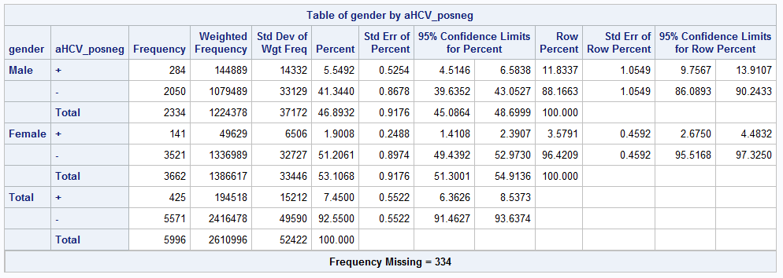
SAS Output

Slide 13
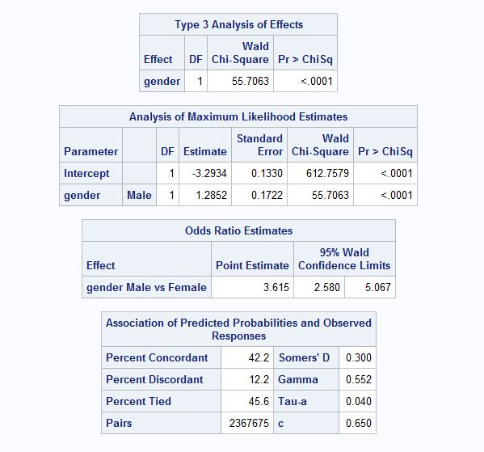
SAS Output
Notes:
For the logistic regression output there is a lot of information but what I would point you to for now is the odds ratio estimates, where we produce an odds ratio for the risk of males vs the risk of females. Again with a 95% confidence limit.

Slide 14
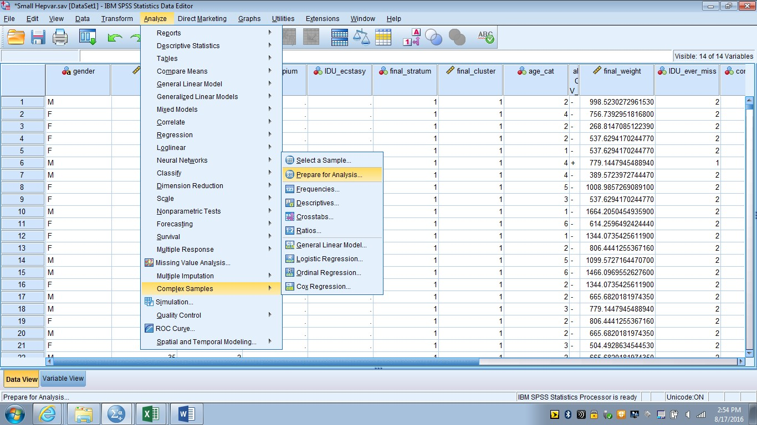

Slide 15
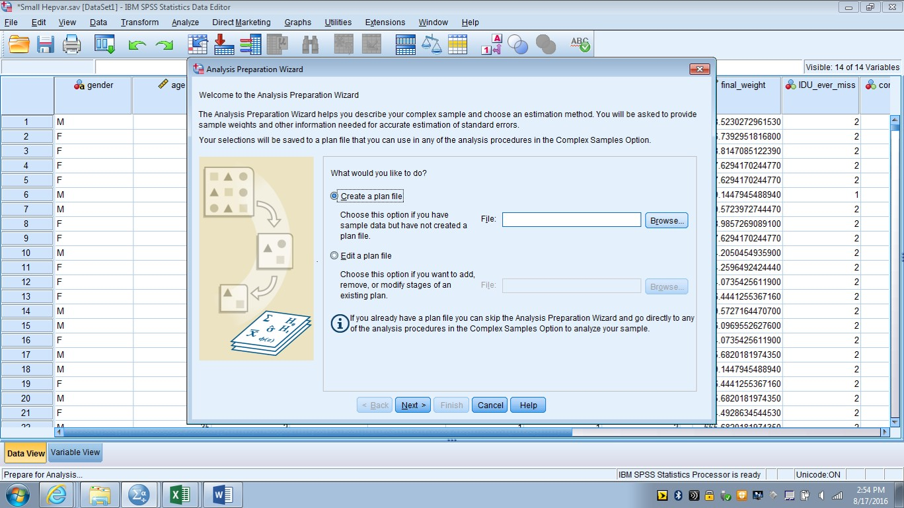

Slide 16
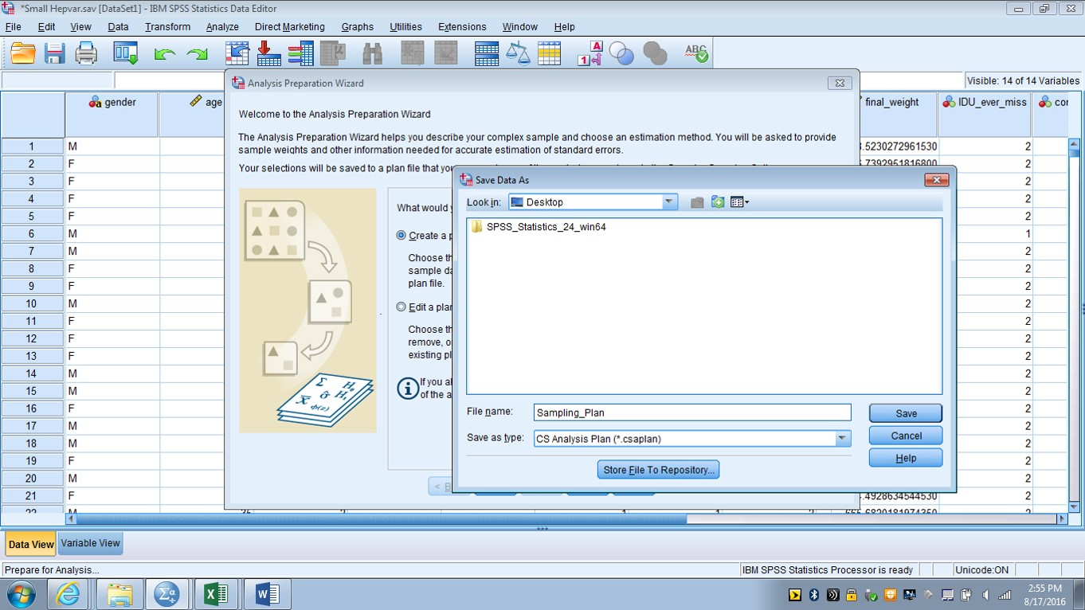

Slide 17
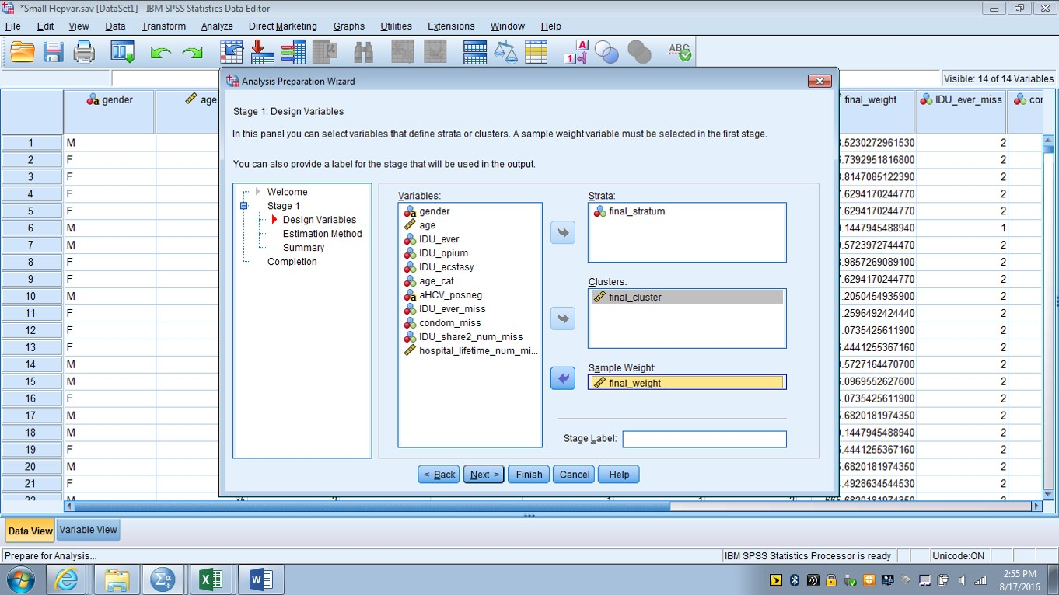

Slide 18
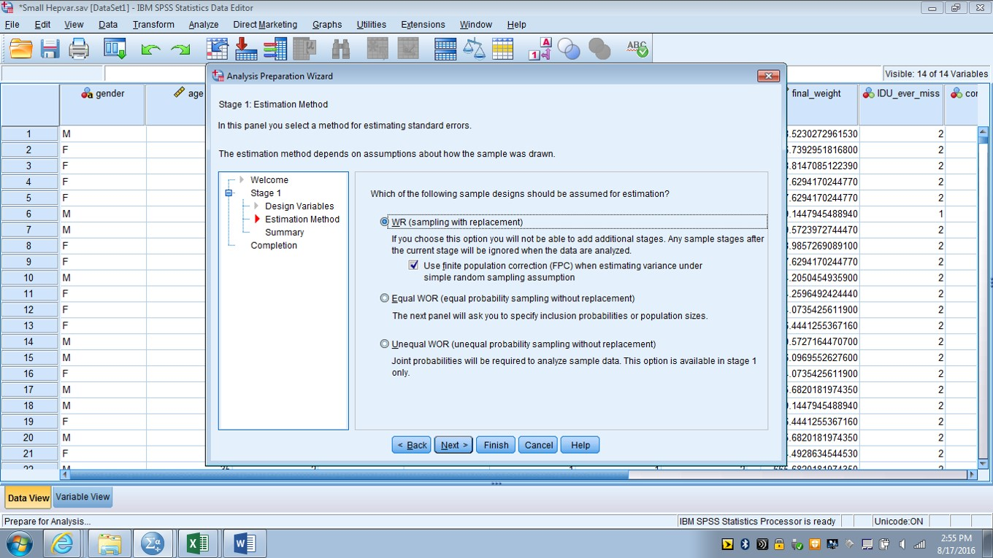

Slide 19
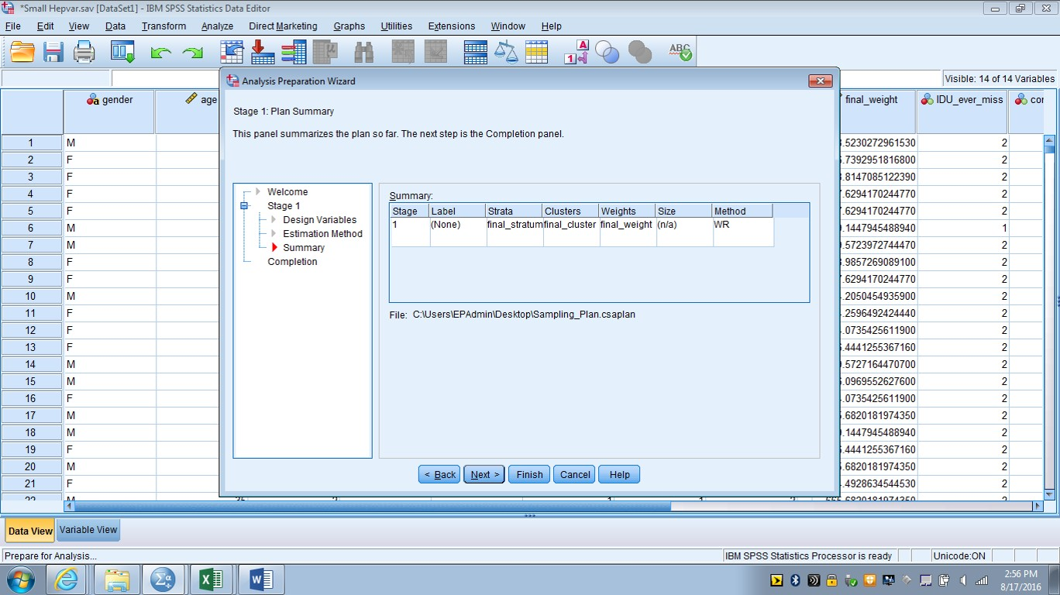

Slide 20
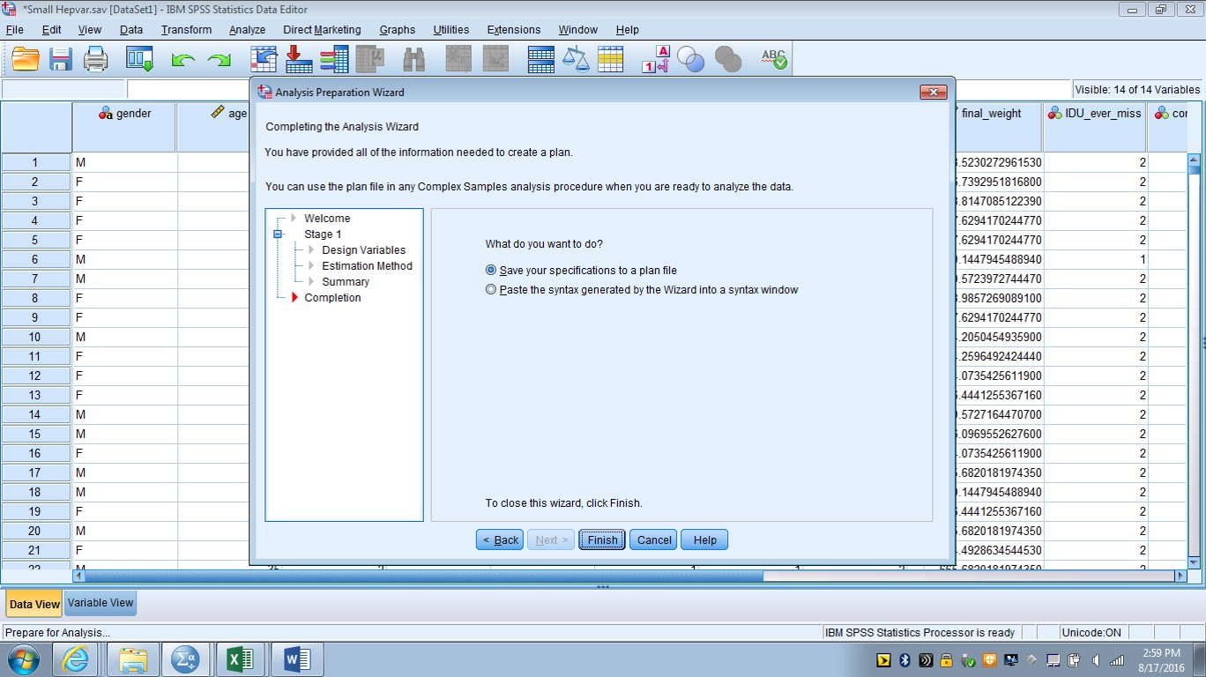

Slide 21
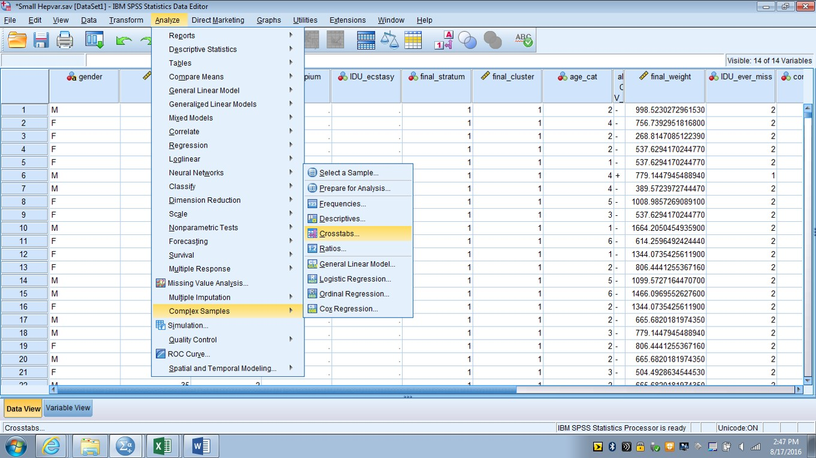

Slide 22
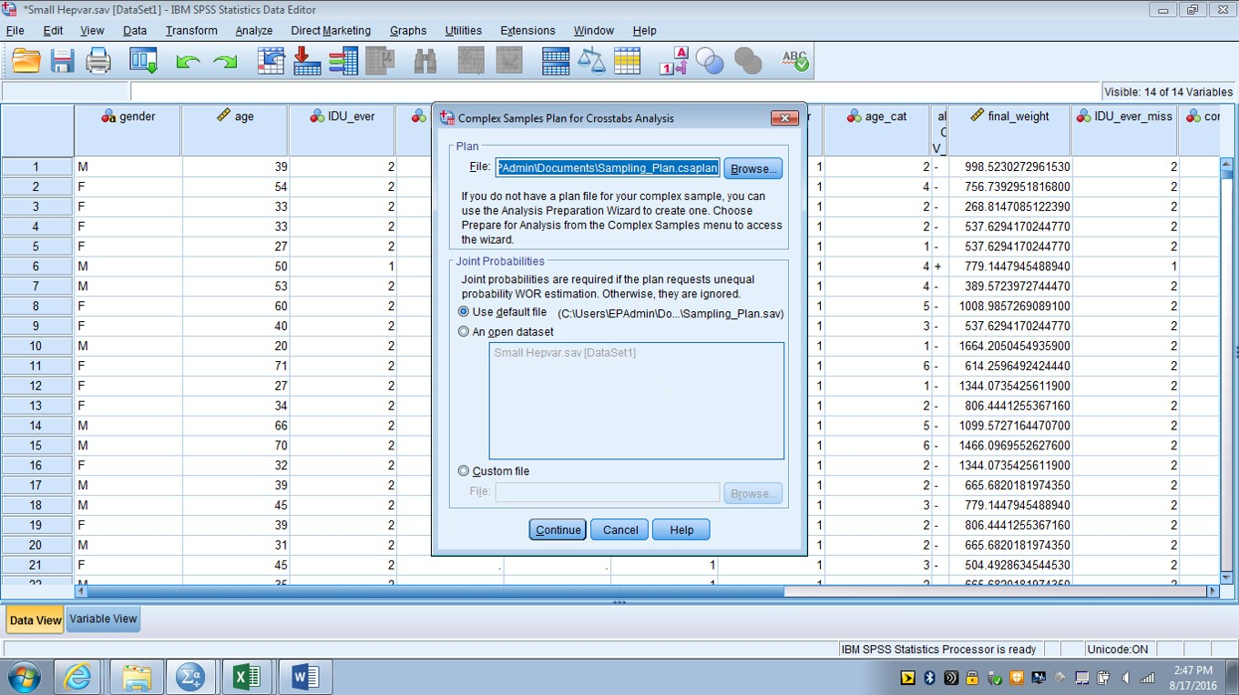

Slide 23
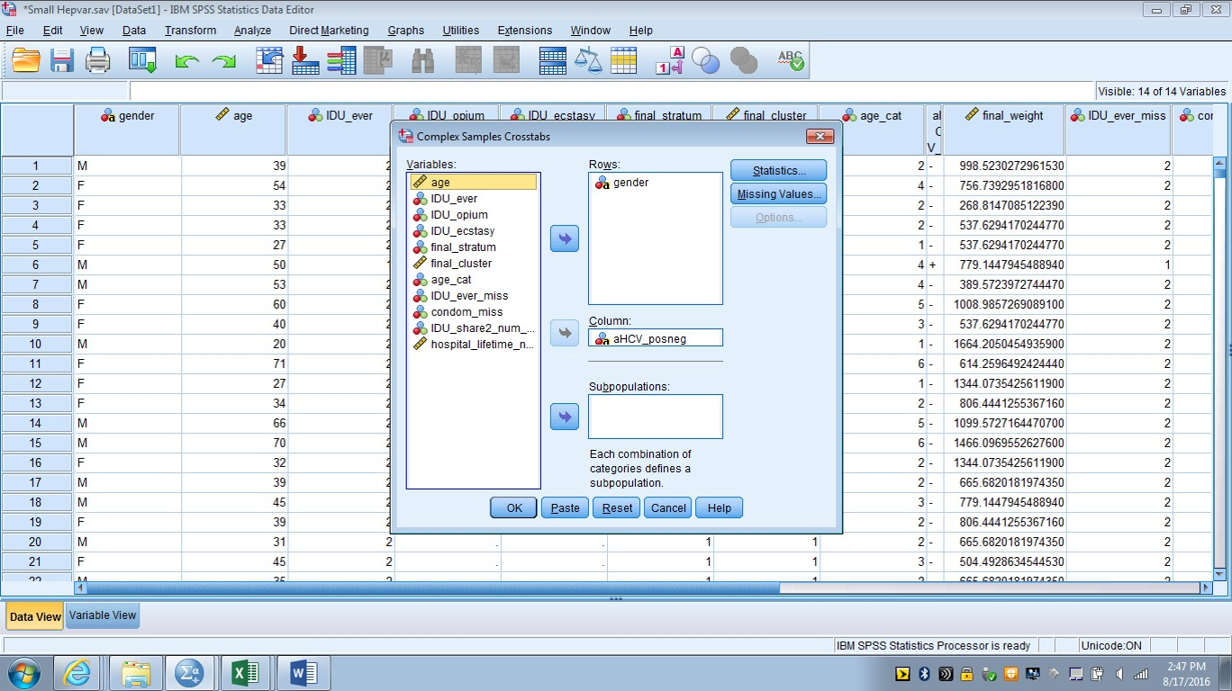

Slide 24
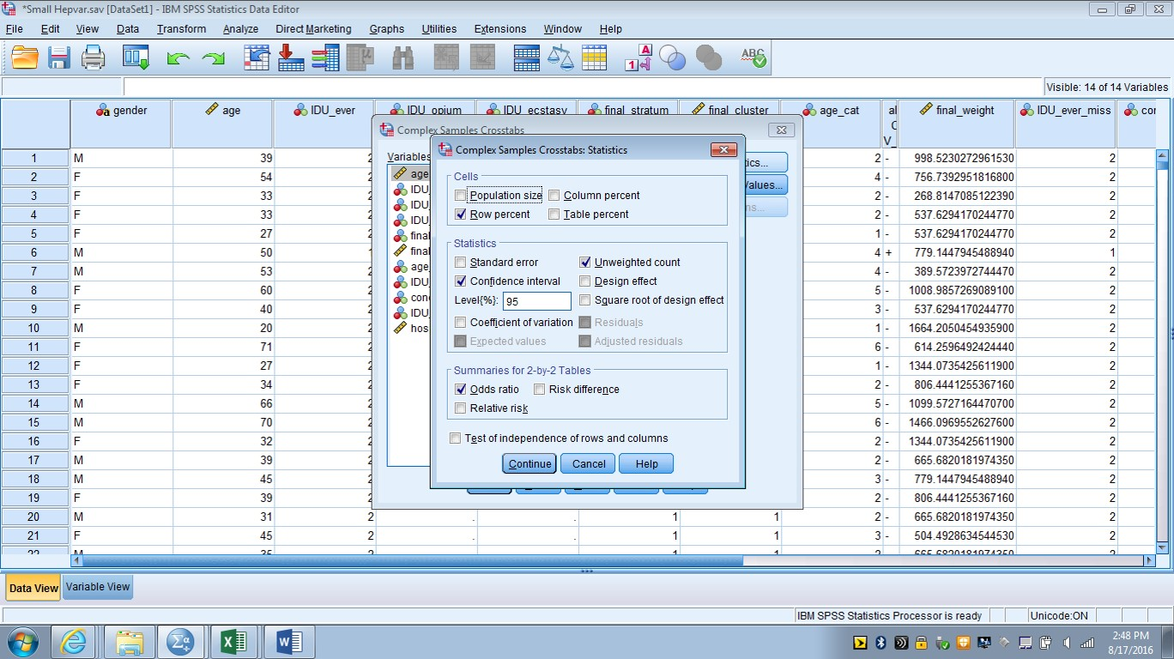

Slide 26
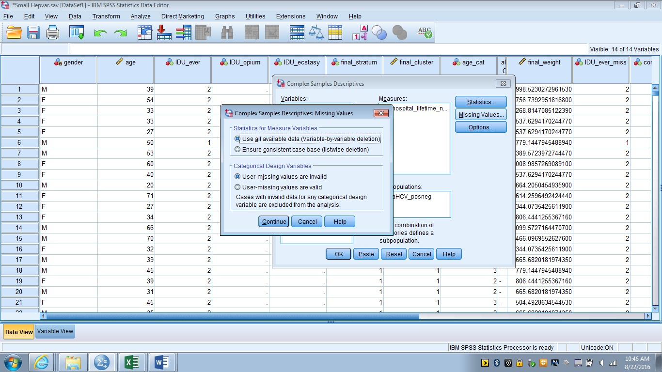
Things to consider
Missing values
Listwise vs. pairwise deletion
Can define value for missing variables in SPSS variable view
Coding of referent groups
Flipped odds ratios

Slide 27
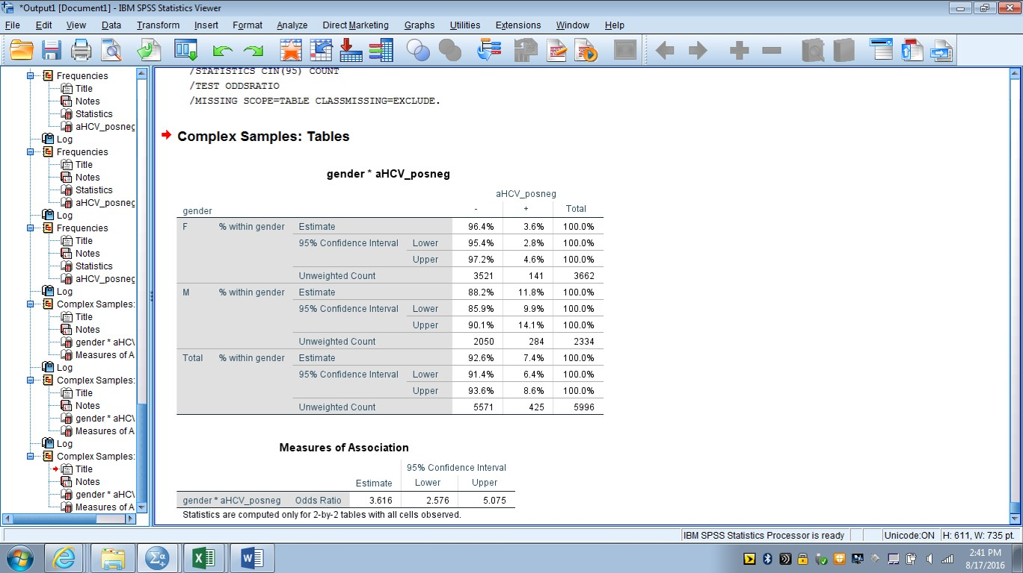

Slide 28
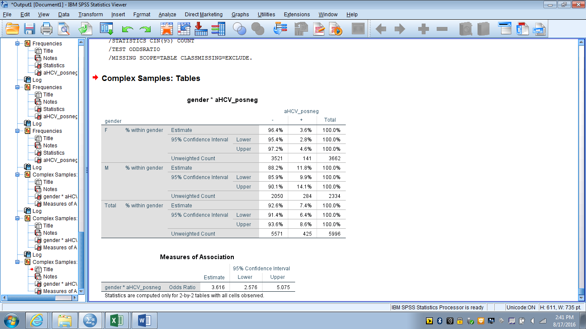

Slide 30
Example code - continuous variable
proc surveymeans data=final.hepvar;
stratum final_stratum;
cluster final_cluster;
weight final_weight;
var hospital_lifetime_num_miss;
domain ahcv_posneg;
run;
proc surveyreg data=final.hepvar;
stratum final_stratum;
cluster final_cluster;
weight final_weight;
class ahcv_posneg;
model hospital_lifetime_num_miss = ahcv_posneg;
run;

Slide 31
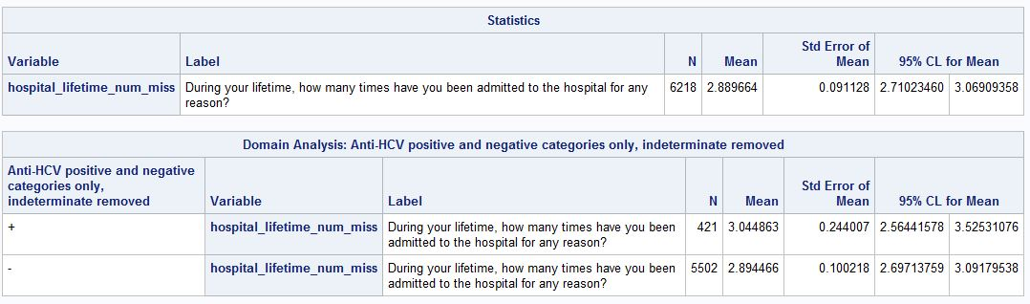
SAS Output

Slide 32
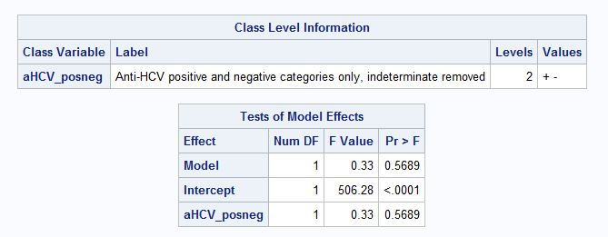
SAS Output

Slide 33
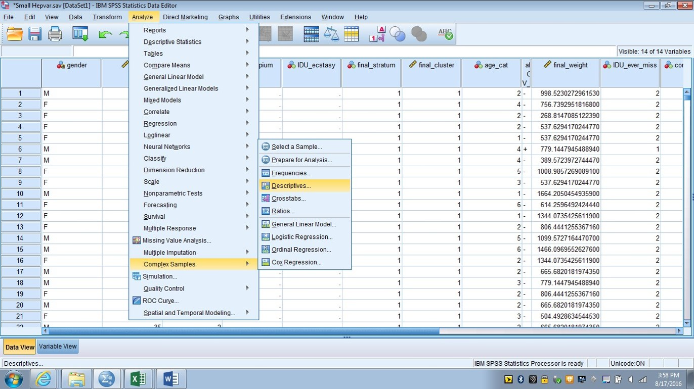

Slide 34
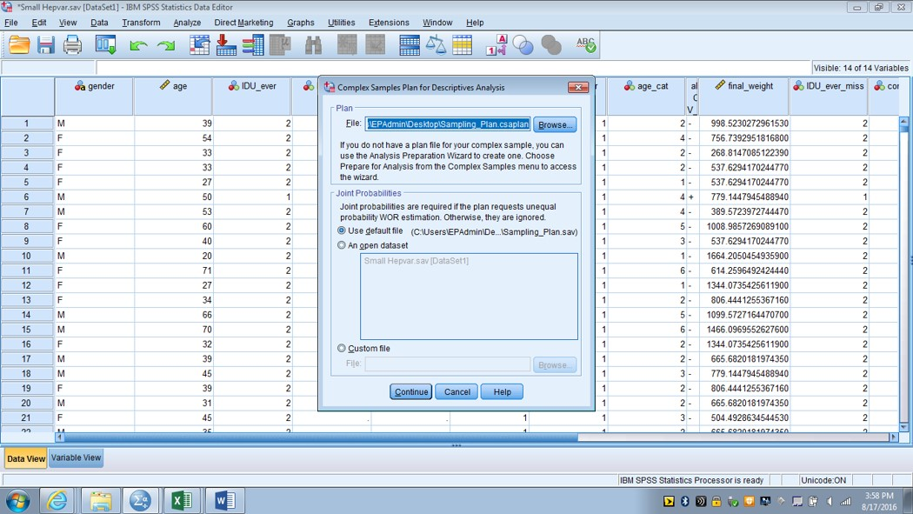

Slide 35
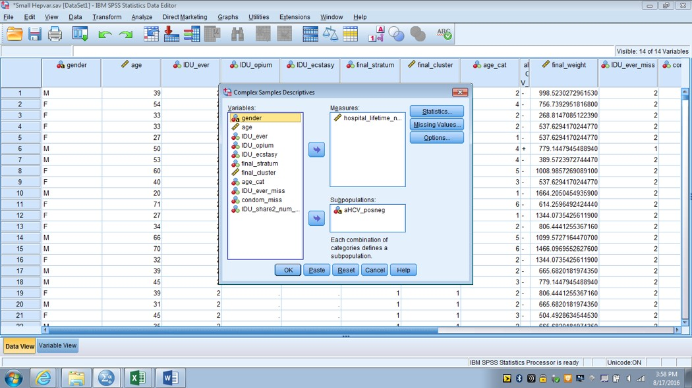

Slide 36
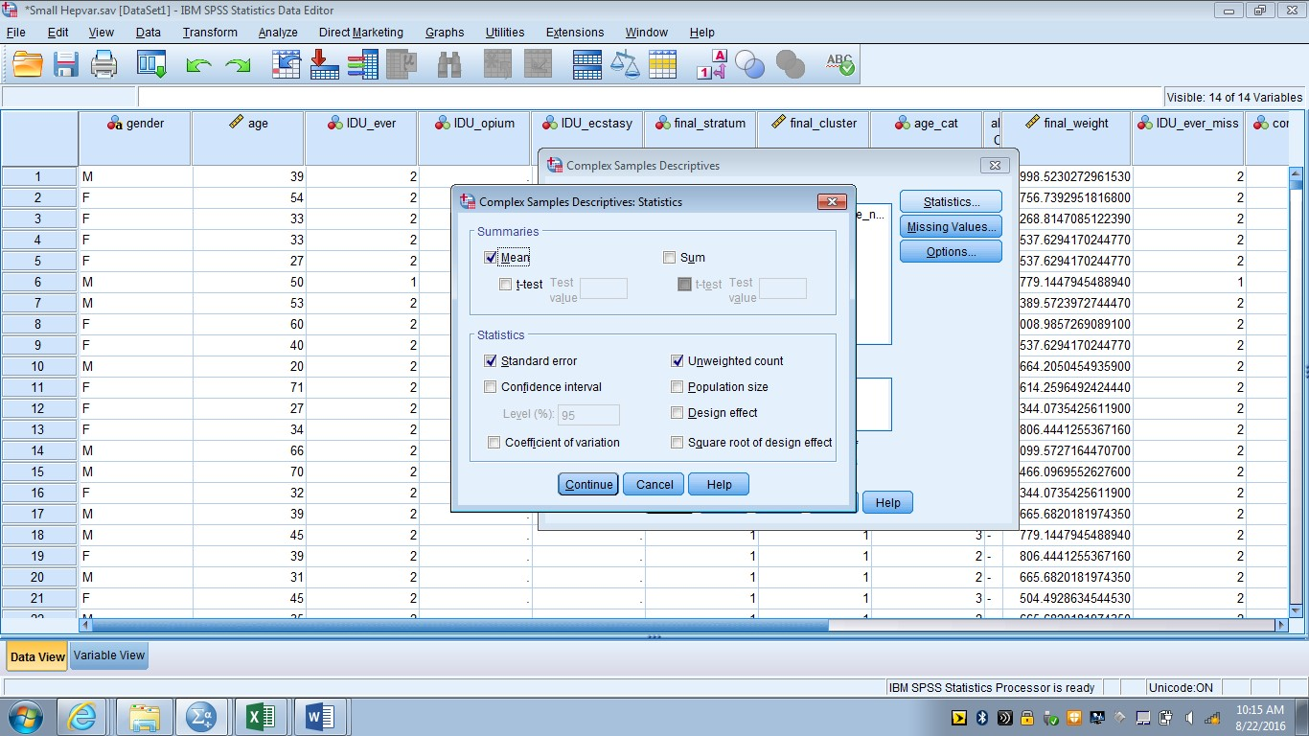

Slide 37
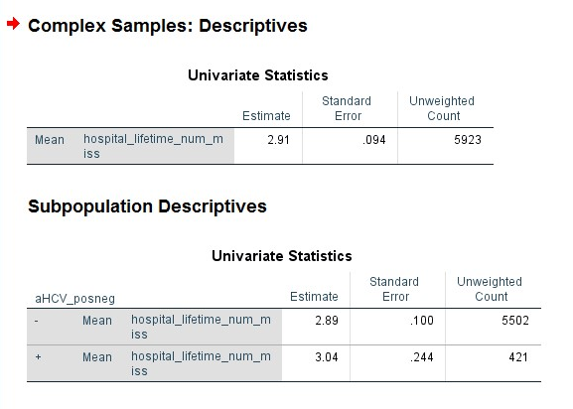

Slide 38
Notes:
So here I actually forgot to include the frequency value for the output, but what you would see if it was there was that it was a 5,900 something instead of 6,218. So for SAS the mean value is for people who were HCV positive, HCV negative, or did not have an answer to the HCV question. In SPSS the outut shows the mean for people who were either positive or negative but drops the missing responses completely. So this is an example of where missing values can be handled slightly differently in different software.

Slide 39
Final Thoughts
Always make sure the sampling design is fully specified in the analysis
Think about missing values
Different software handles this in different ways
Make sure referent groups are specified correctly for odds ratios
Use an appropriate statistical analysis
Applicable to your type of data
Relevant to the specific research question
Notes:
This is critical to make sure your confidence interval estimates are going to be correct. Any stratification, clustering, or weighting needs to be accounted for.
So it’s important to have that in mind so it does not come as a total surprise. One thing I make sure to do is always check my un-weighted frequencies to make sure I have the number of observations I was expecting. That way you are less likely to run into trouble because of different software handling missing values in different ways.
You don’t want to report an odds ratio of .5 when the odds ratio was actually 2 because you didn’t specify your odds ratio correctly.

Slide 40
Thanks for listening. Any questions?
Steven Russell
ykf1@cdc.gov

